Slide 1
Water Management system
Group 3
Nguyễn Xuân Tùng BI10-188
Nguyễn Quang Anh BI10-012
Trần Hồng Quân BI10-149
Lữ Khánh Huyền BI10-083
Vũ Đức Chính BI10-024

Slide 2


01
02
Table of content
03
Objective and Approach
Database
Entity Relationship Diagram
Database Schema
Database Implementation
GUI
Login
Admin Window
Employee Window
Customer Window

Slide 3
Objective and Approach
1.1 Objective:
Water Supply Management System
The target of the system is to provide information about water supply, especially data about:
Suppliers
Areas
Households
Employees
and help to manage these information
1.2 Approach:
Tkinter For GUI
SQLite For Database
AI to design images

Slide 4
2.
ERD
Database Schema
Database Queries
Database

Slide 5
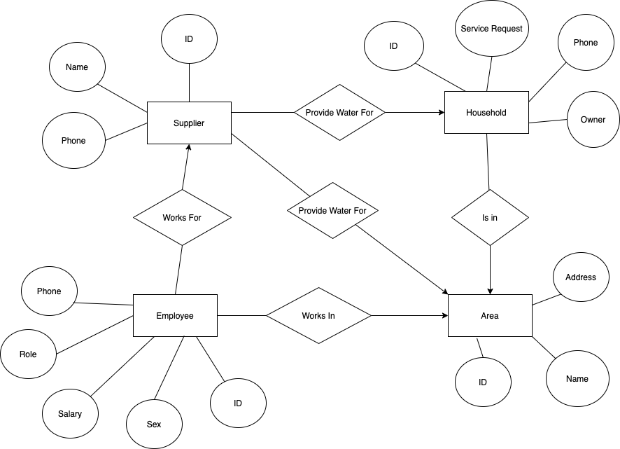
2.1 ERD

Slide 6
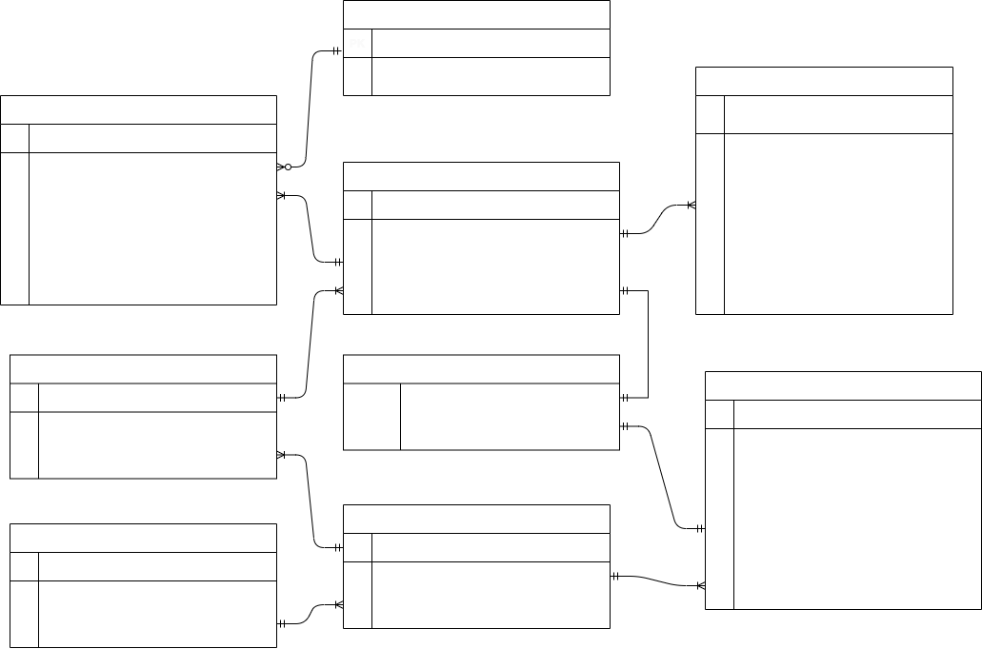
2.2 Database Schema

Slide 7
2.3 Database
Queries
Create Tables
Basic Queries:
- Add - Update - Search - Delete
Other Queries

Slide 8
3.
GUI
Login
Admin Window
Employee Window
Customer Window

Slide 9
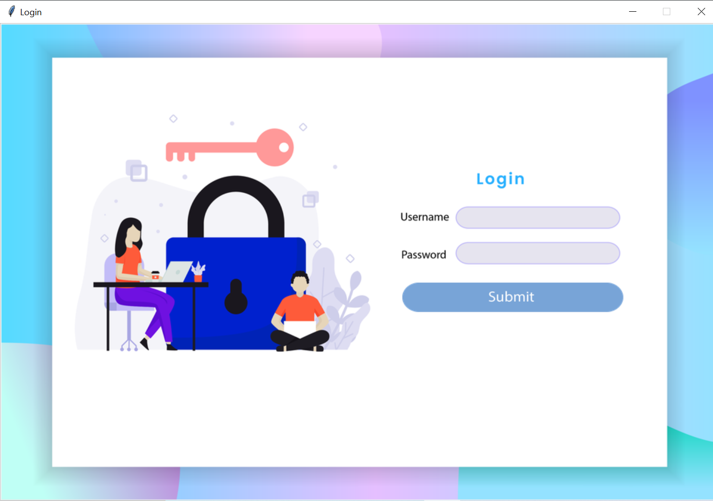
3.1 Login Window
Entries:
Username
Password
Login to get to 3 different windows:
Admin Window
Employee Window
Customer Window

Slide 10
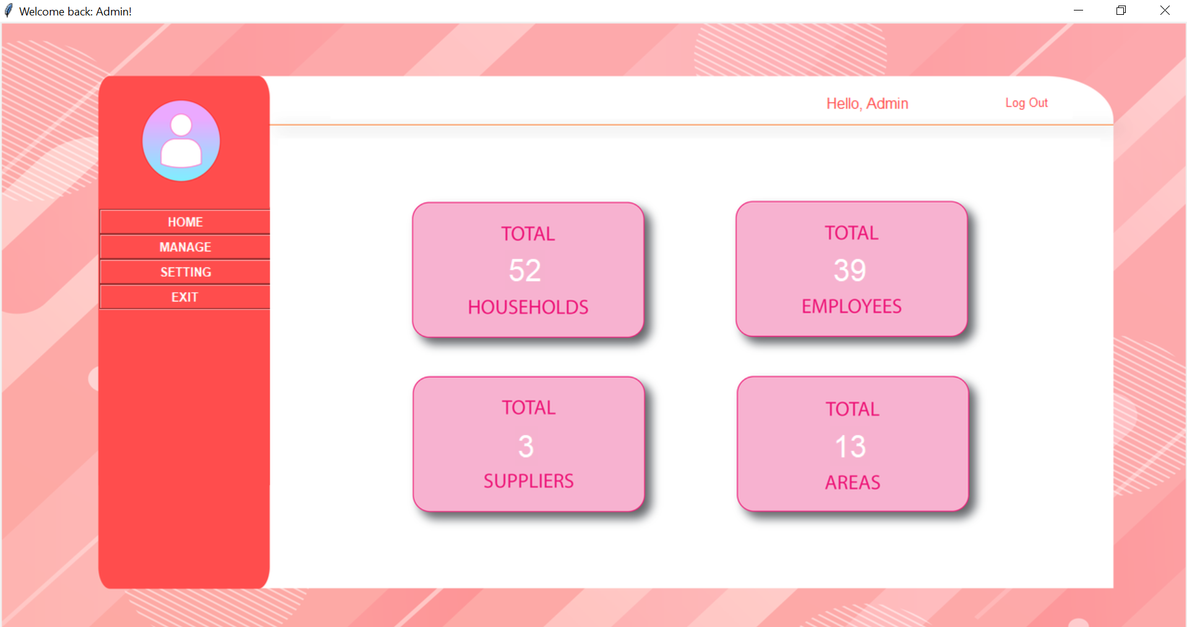
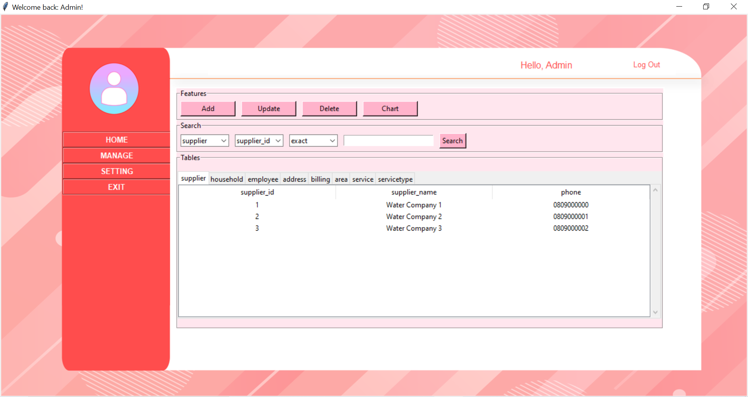
3.2 Admin Window
Home frame
Main Features:
Home
Management
Setting (Changing Password)
Log Out
Exit
Management frame

Slide 11
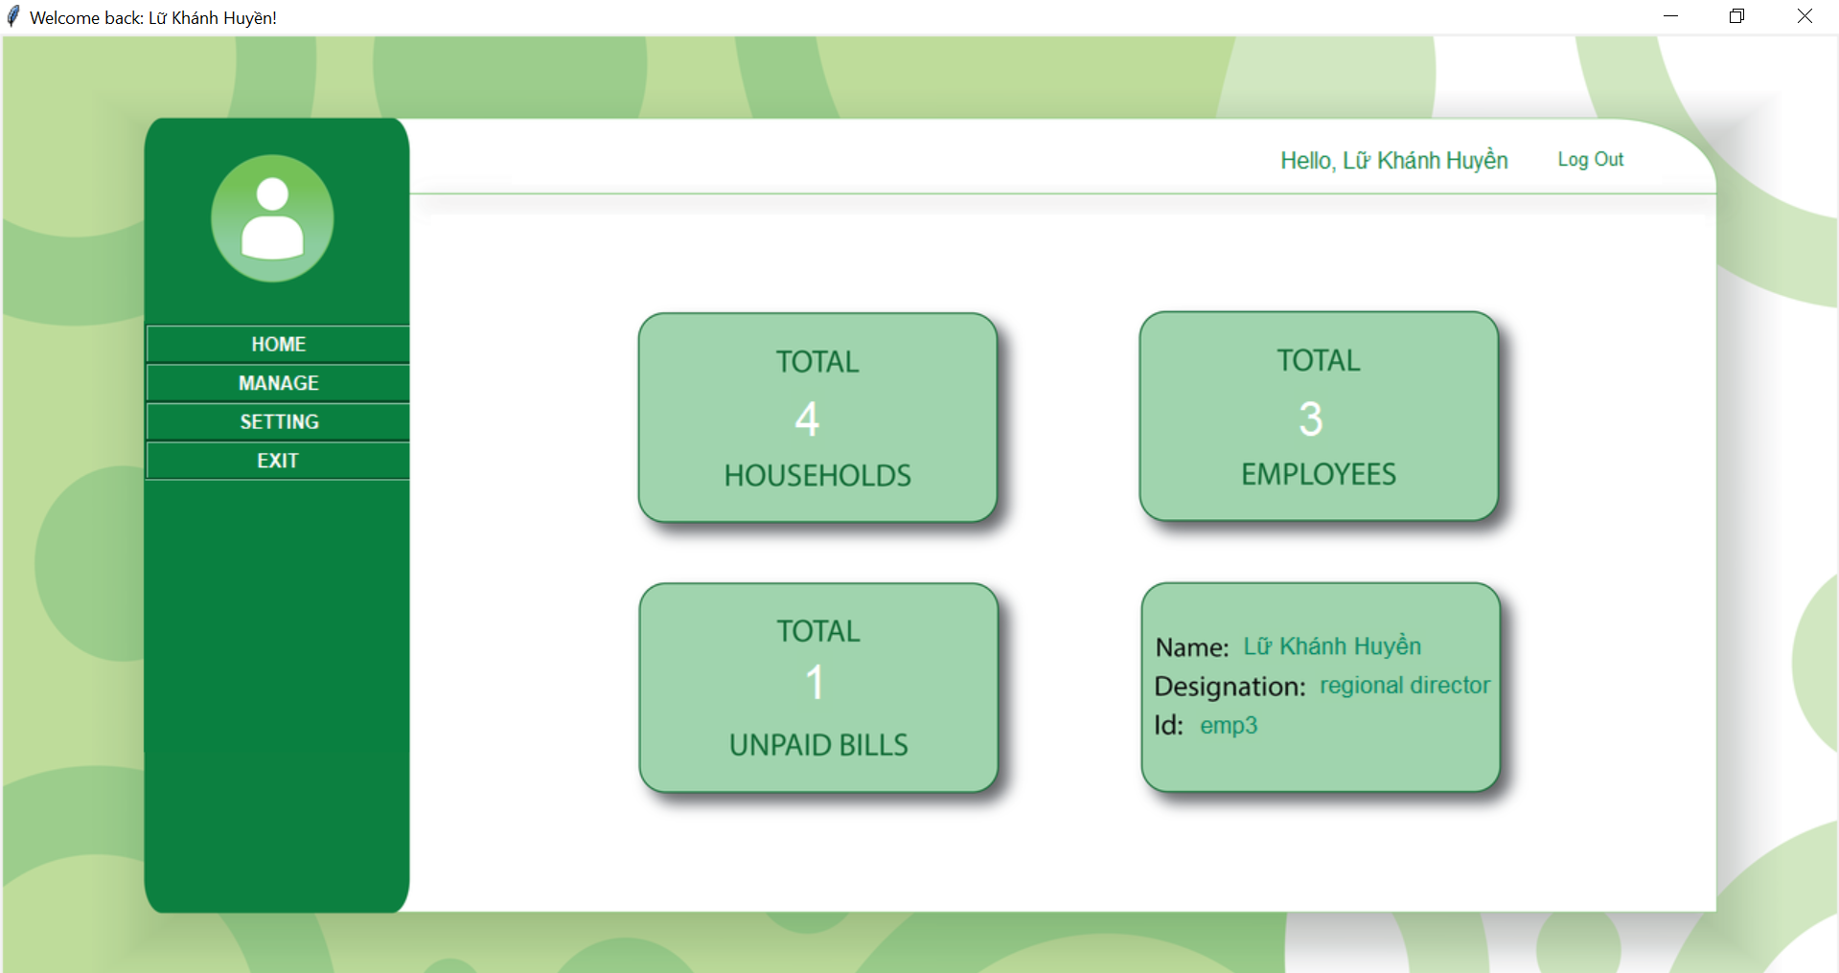
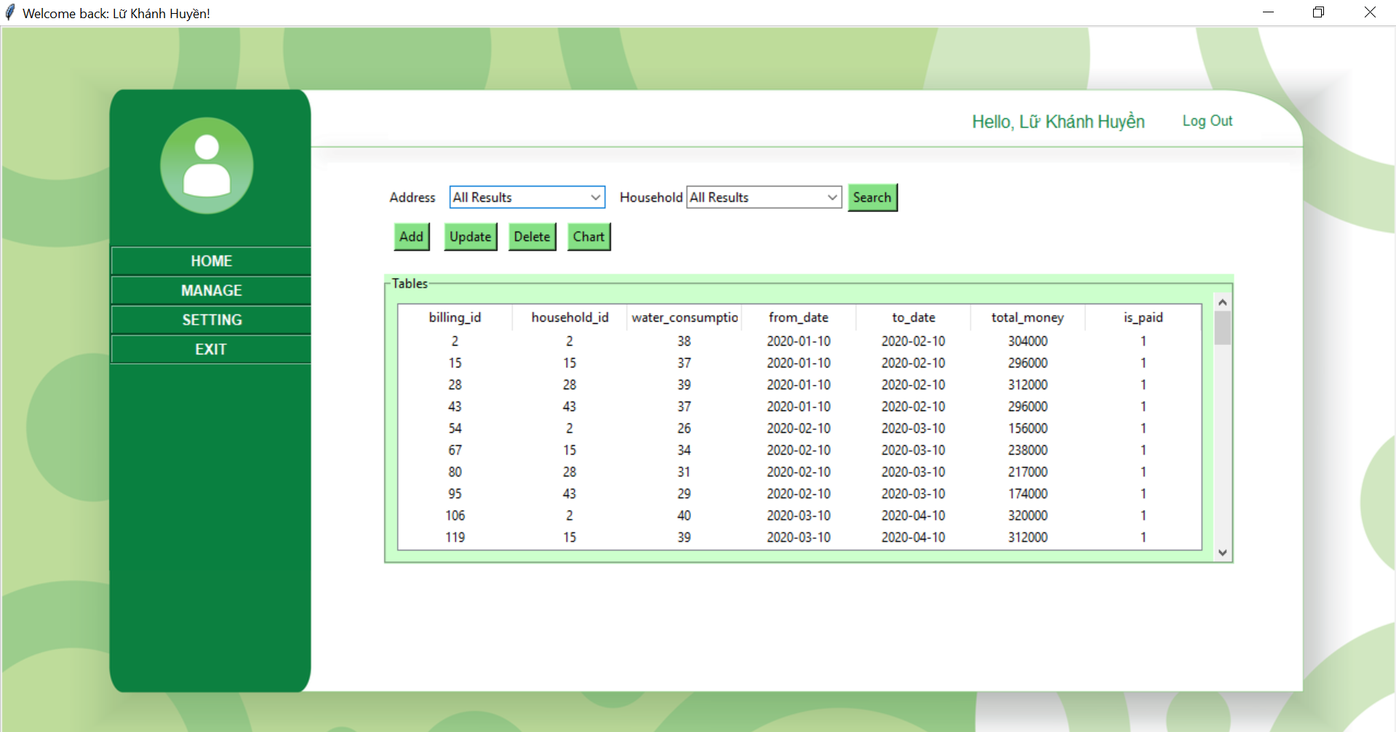
3.3 Employee Window
Home frame
Main Features:
Home
Management
Setting (Changing Password)
Log Out
Exit
Management frame

Slide 12
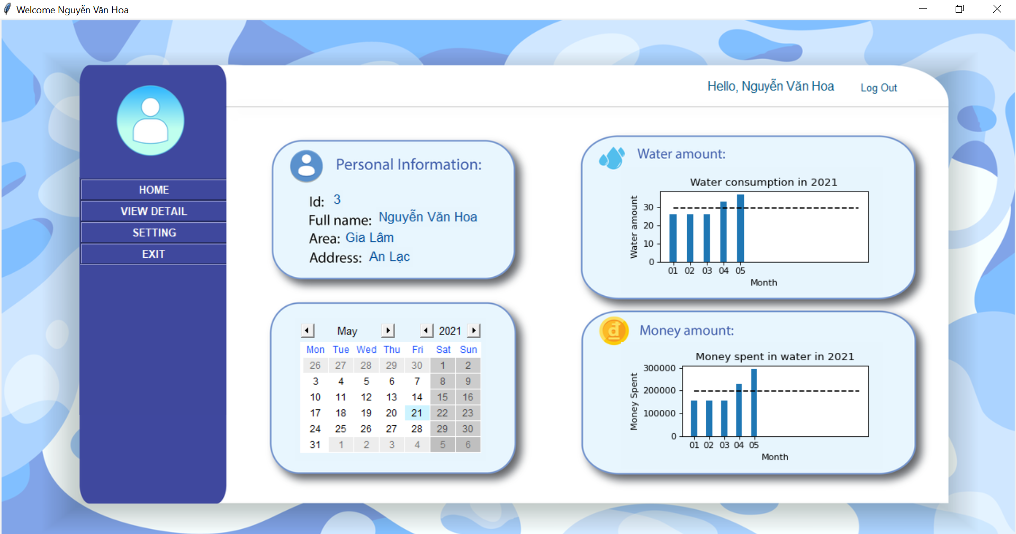
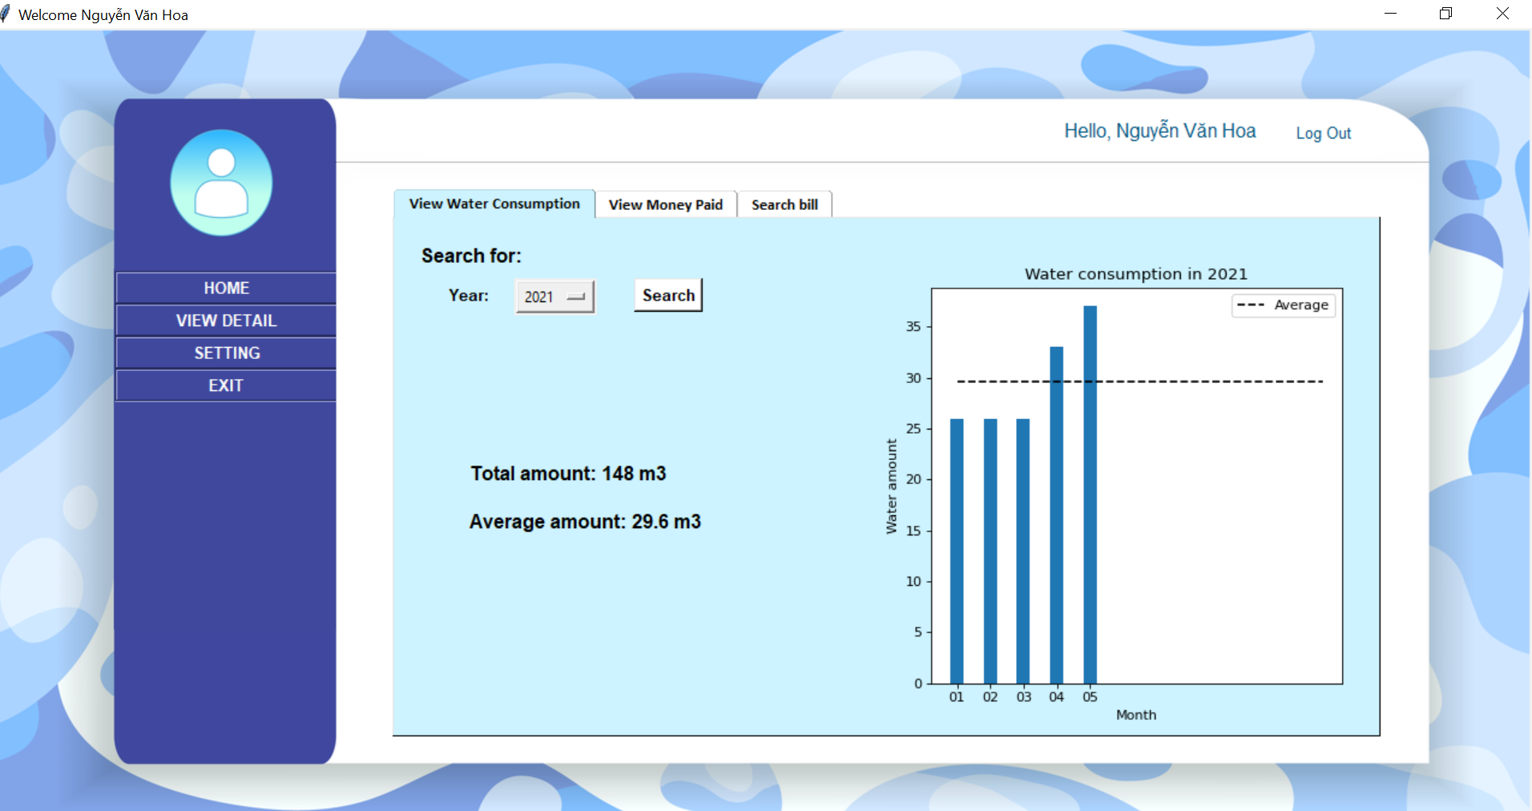
3.4 Customer Window
Home frame
Main Features:
Home
Management
Setting (Changing Password)
Log Out
Exit
Management frame

Slide 13
Thank You For Listening
Now it is time for demo

